Slide 1
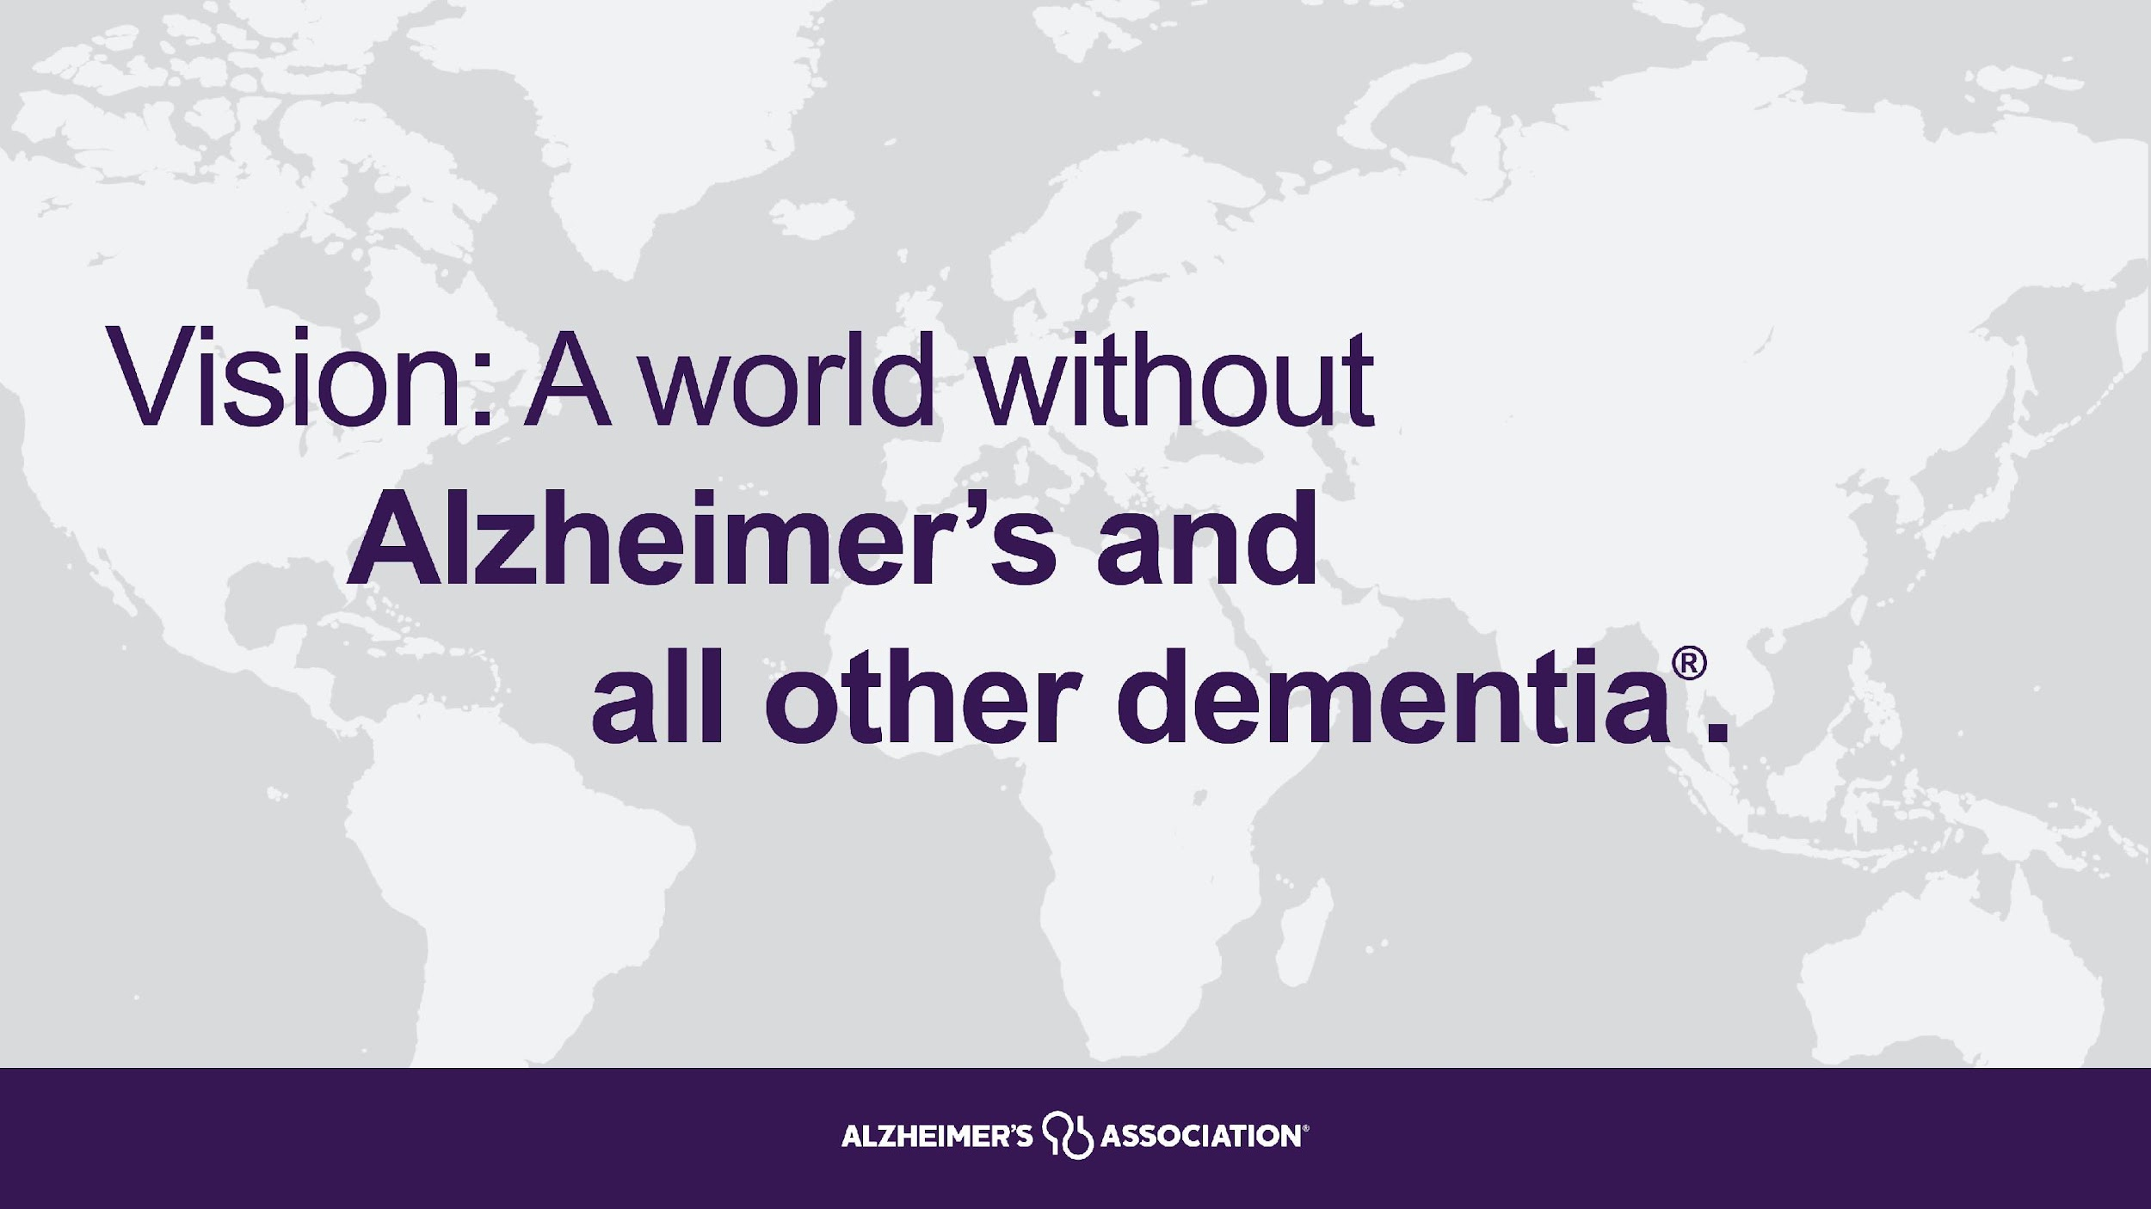

Slide 2
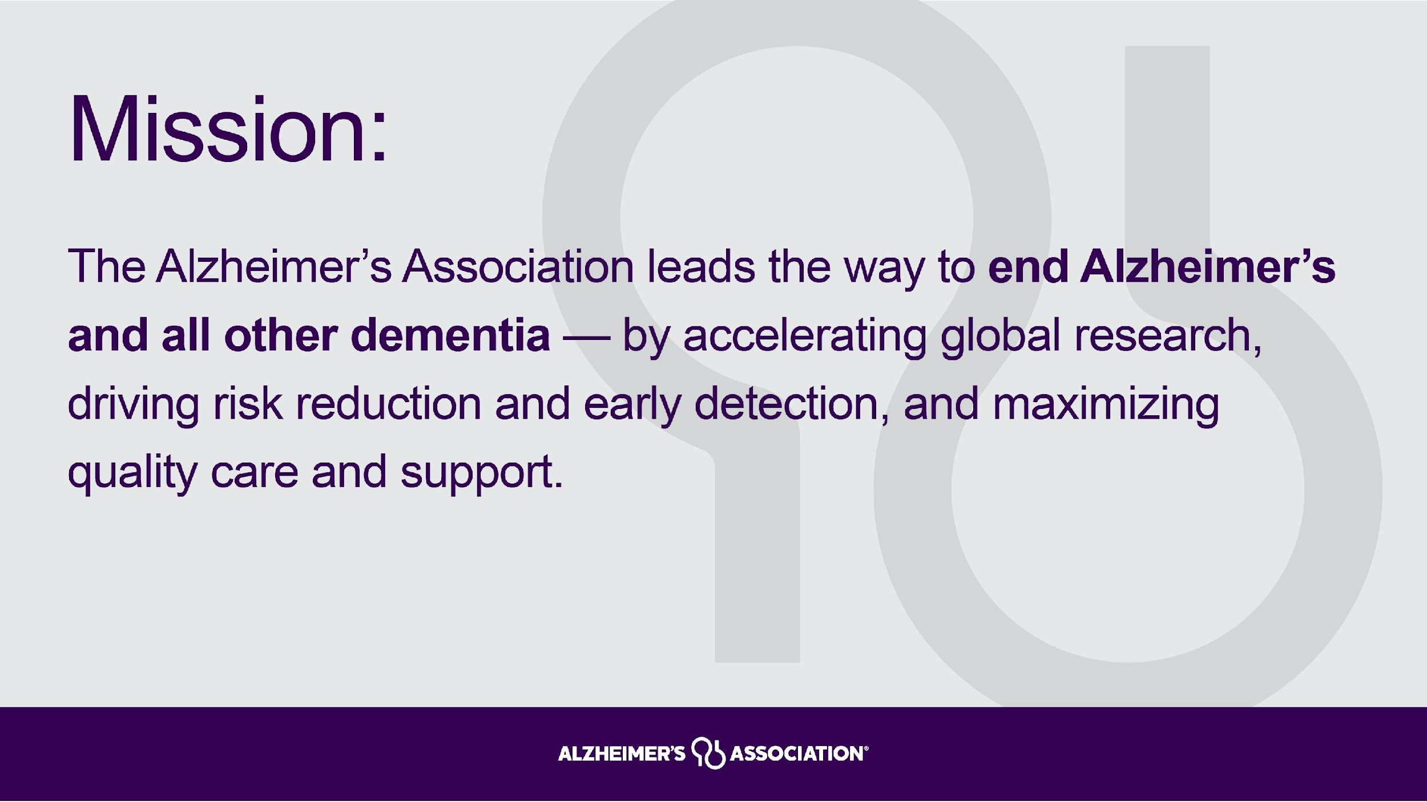

Slide 3
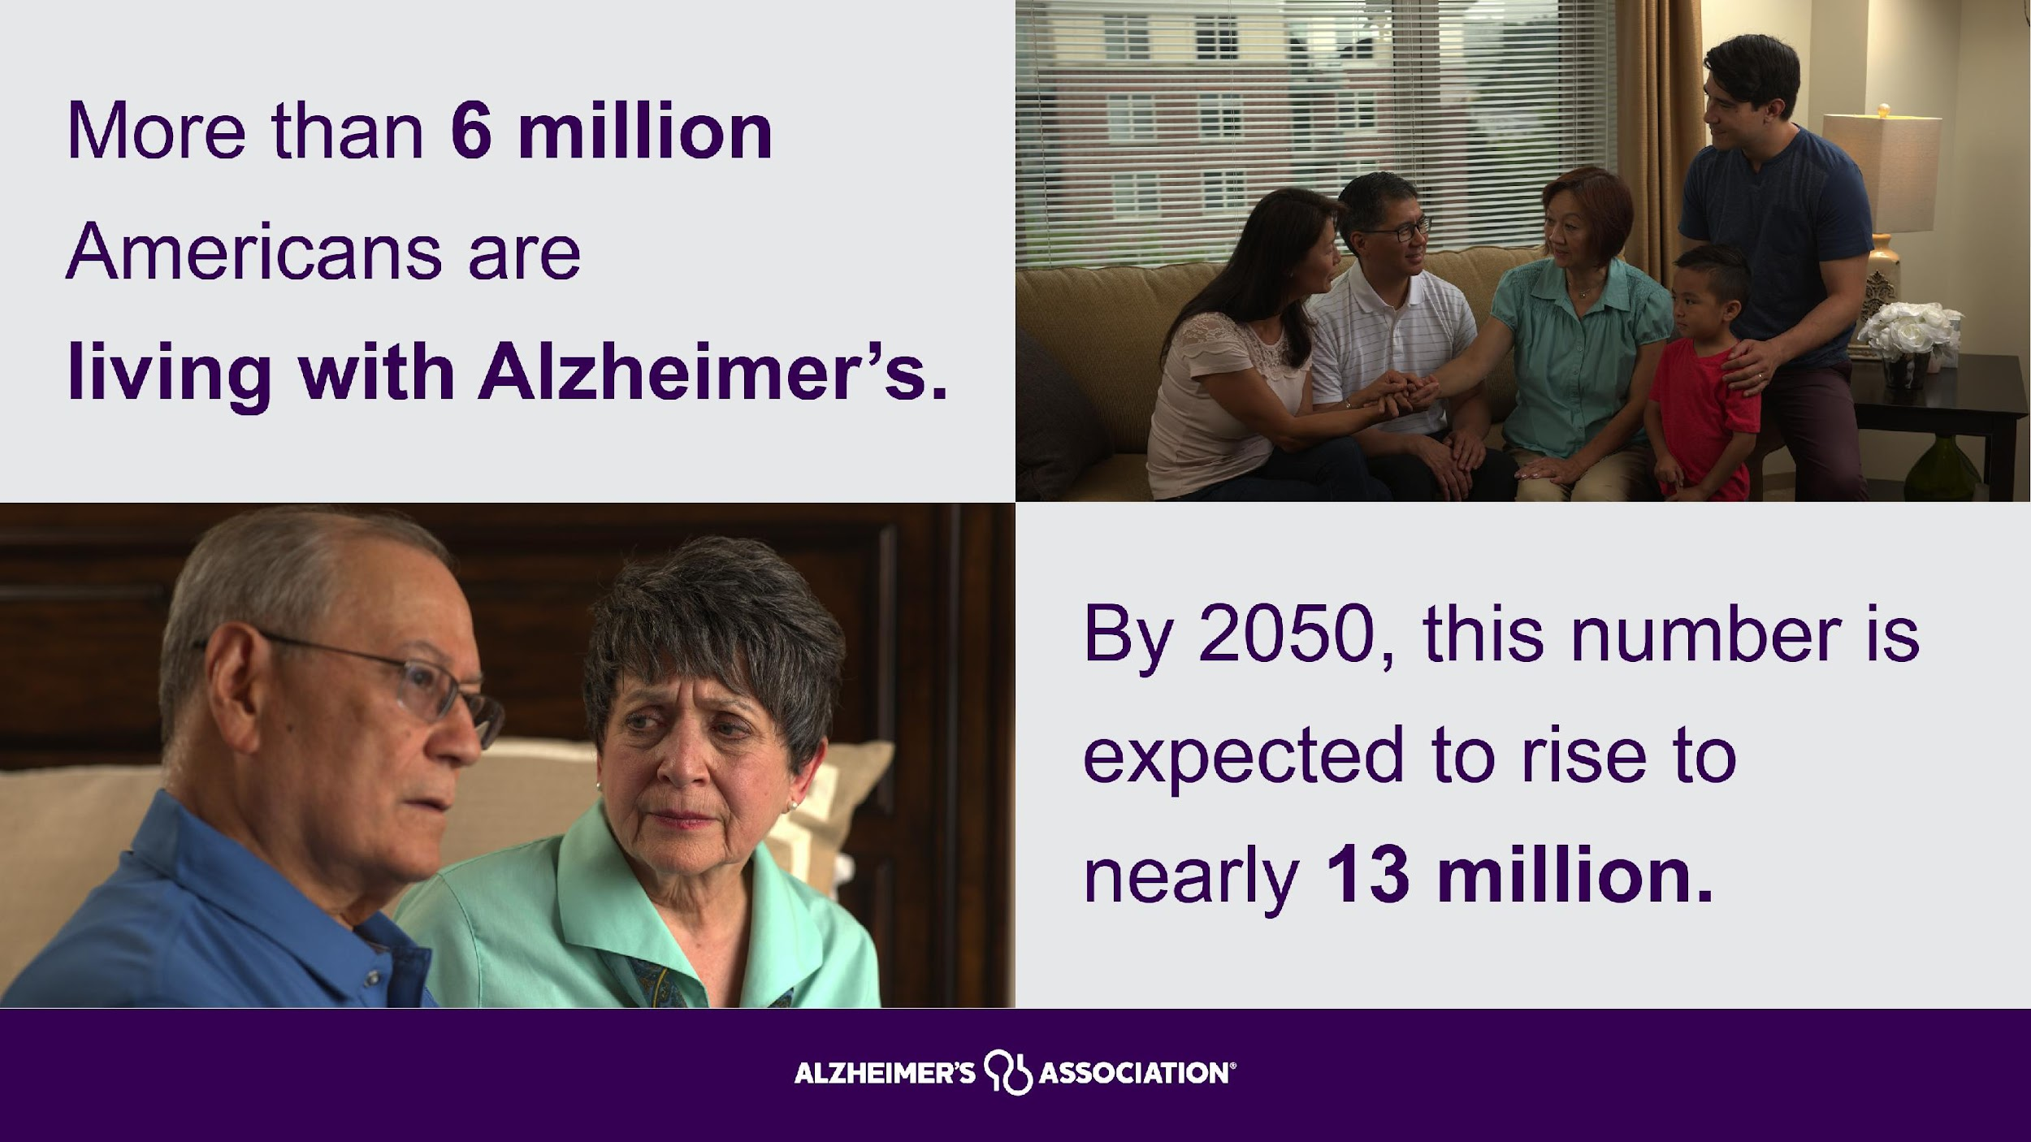

Slide 4
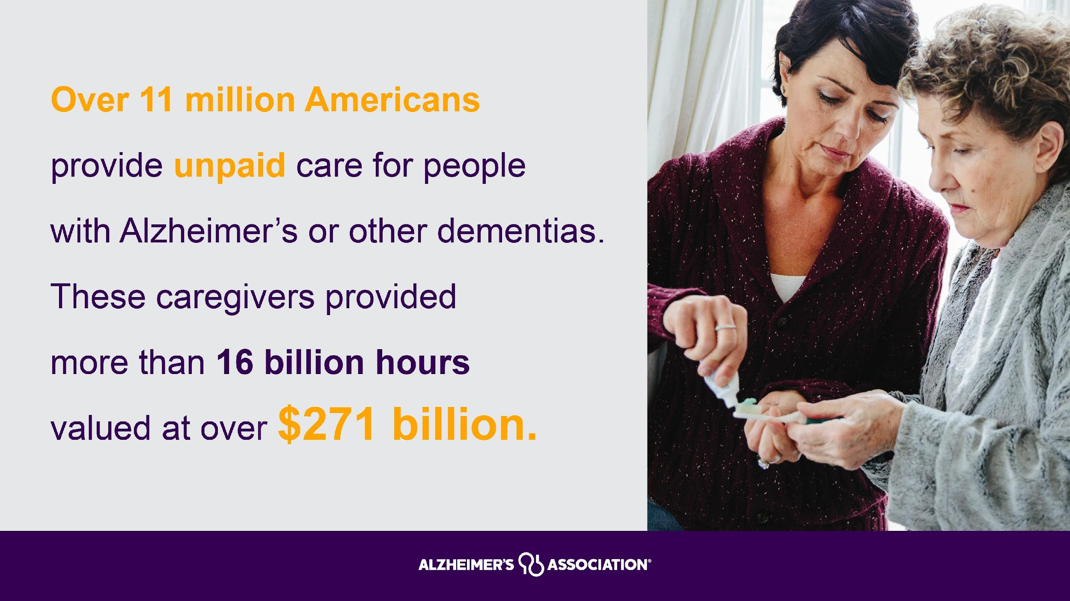

Slide 5
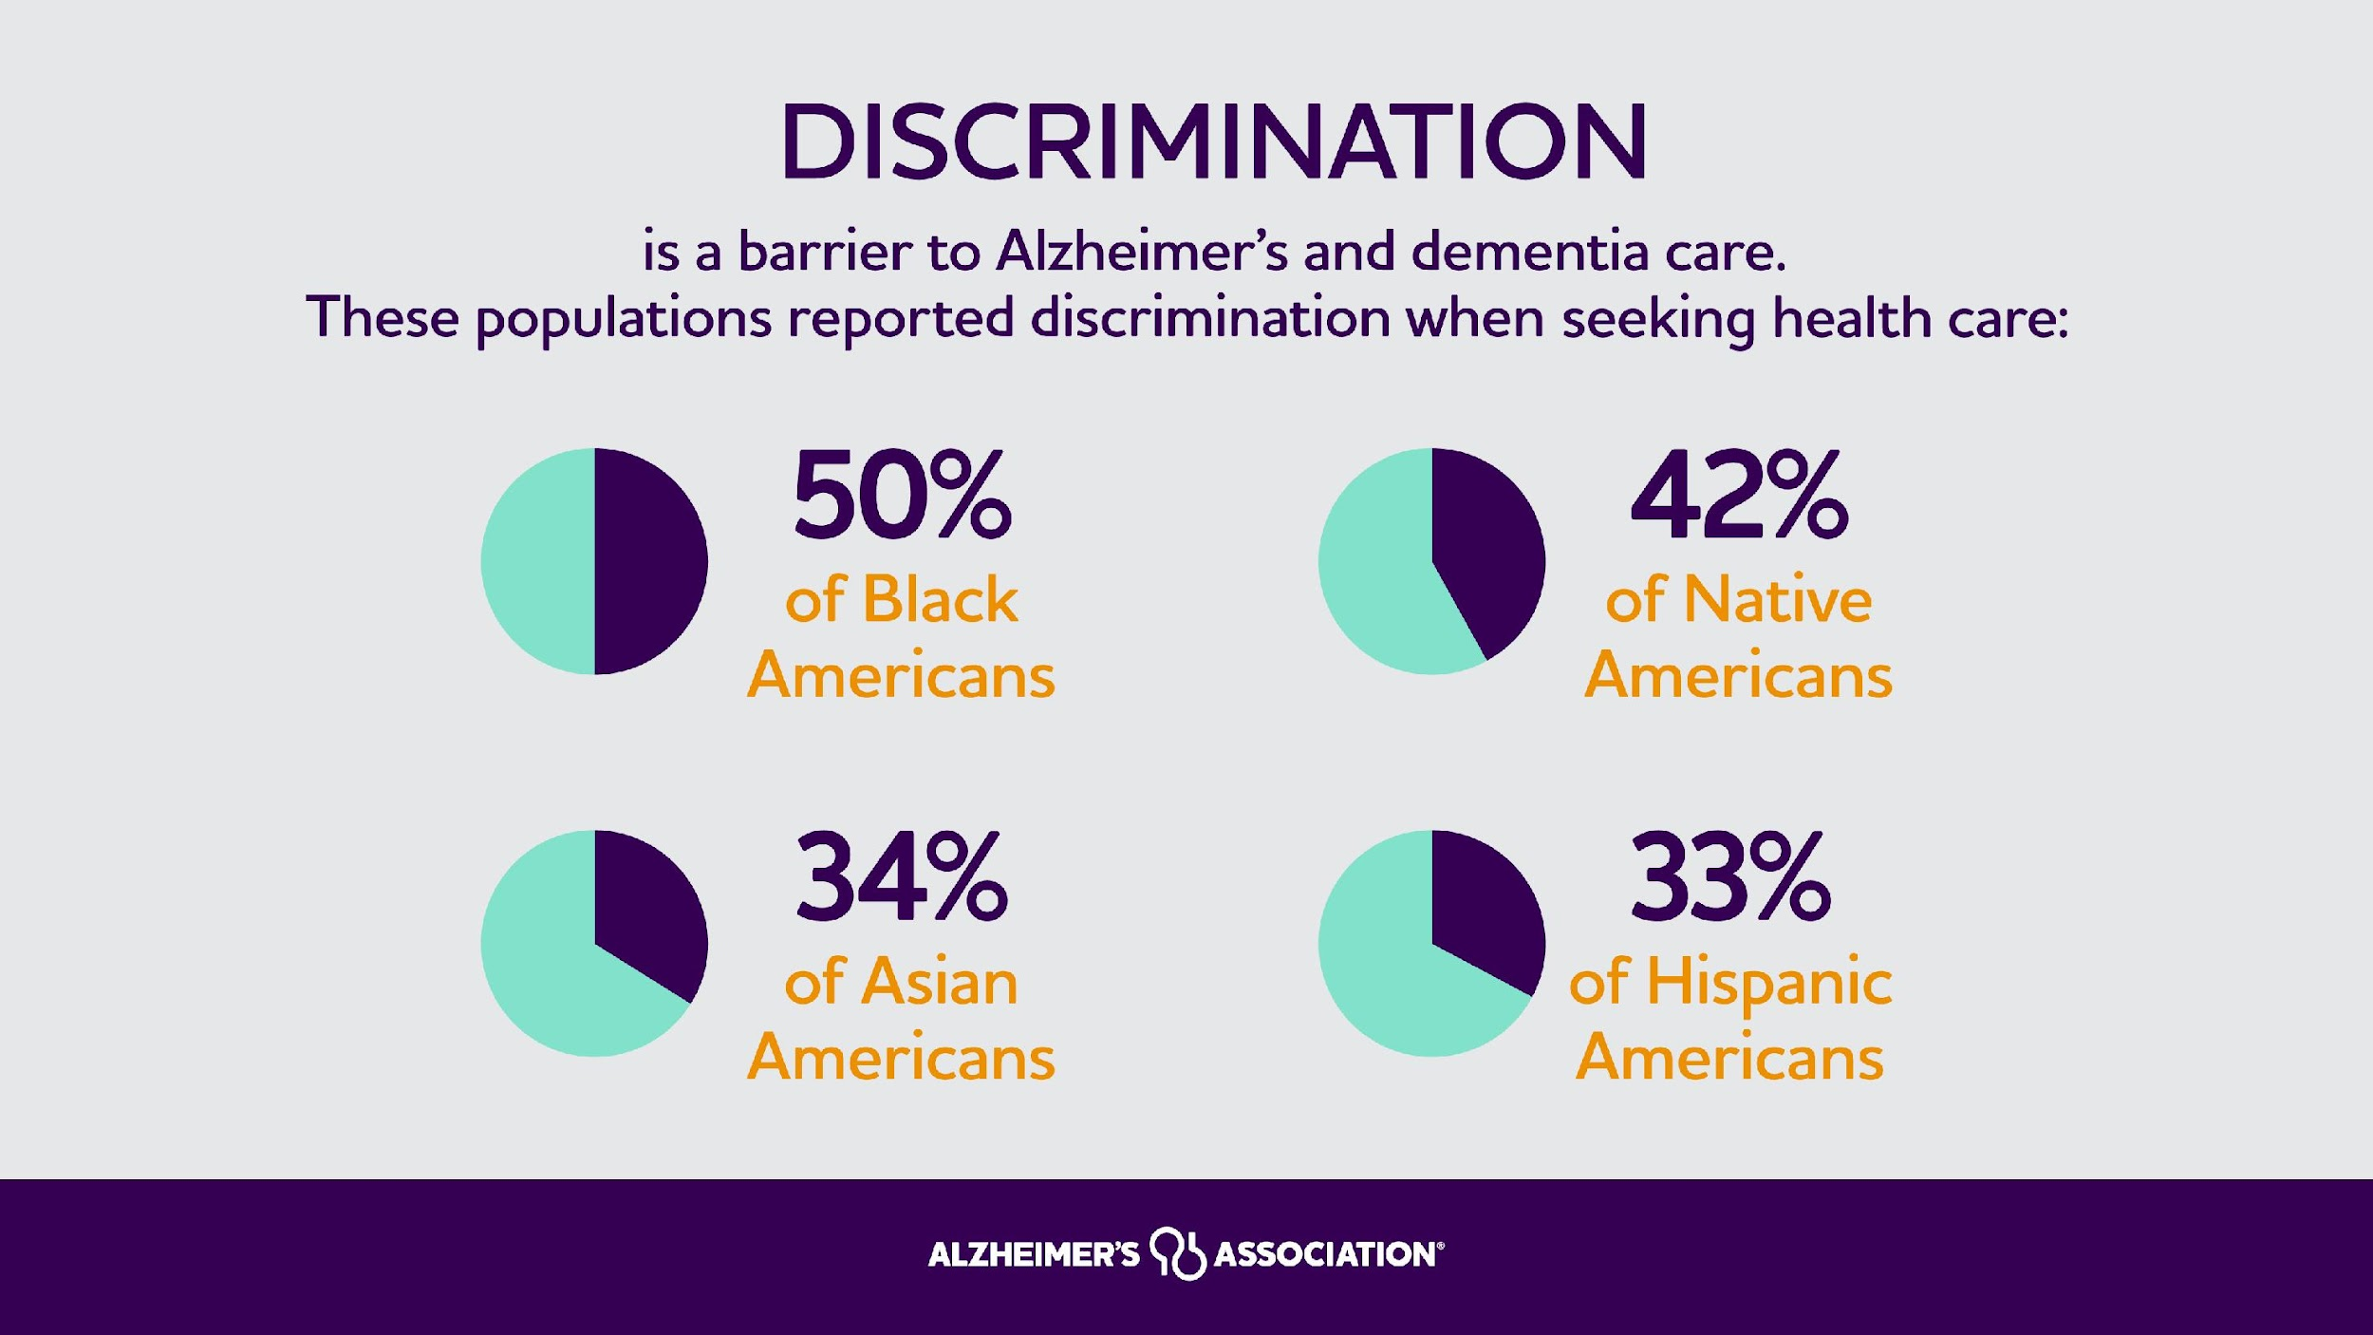

Slide 6
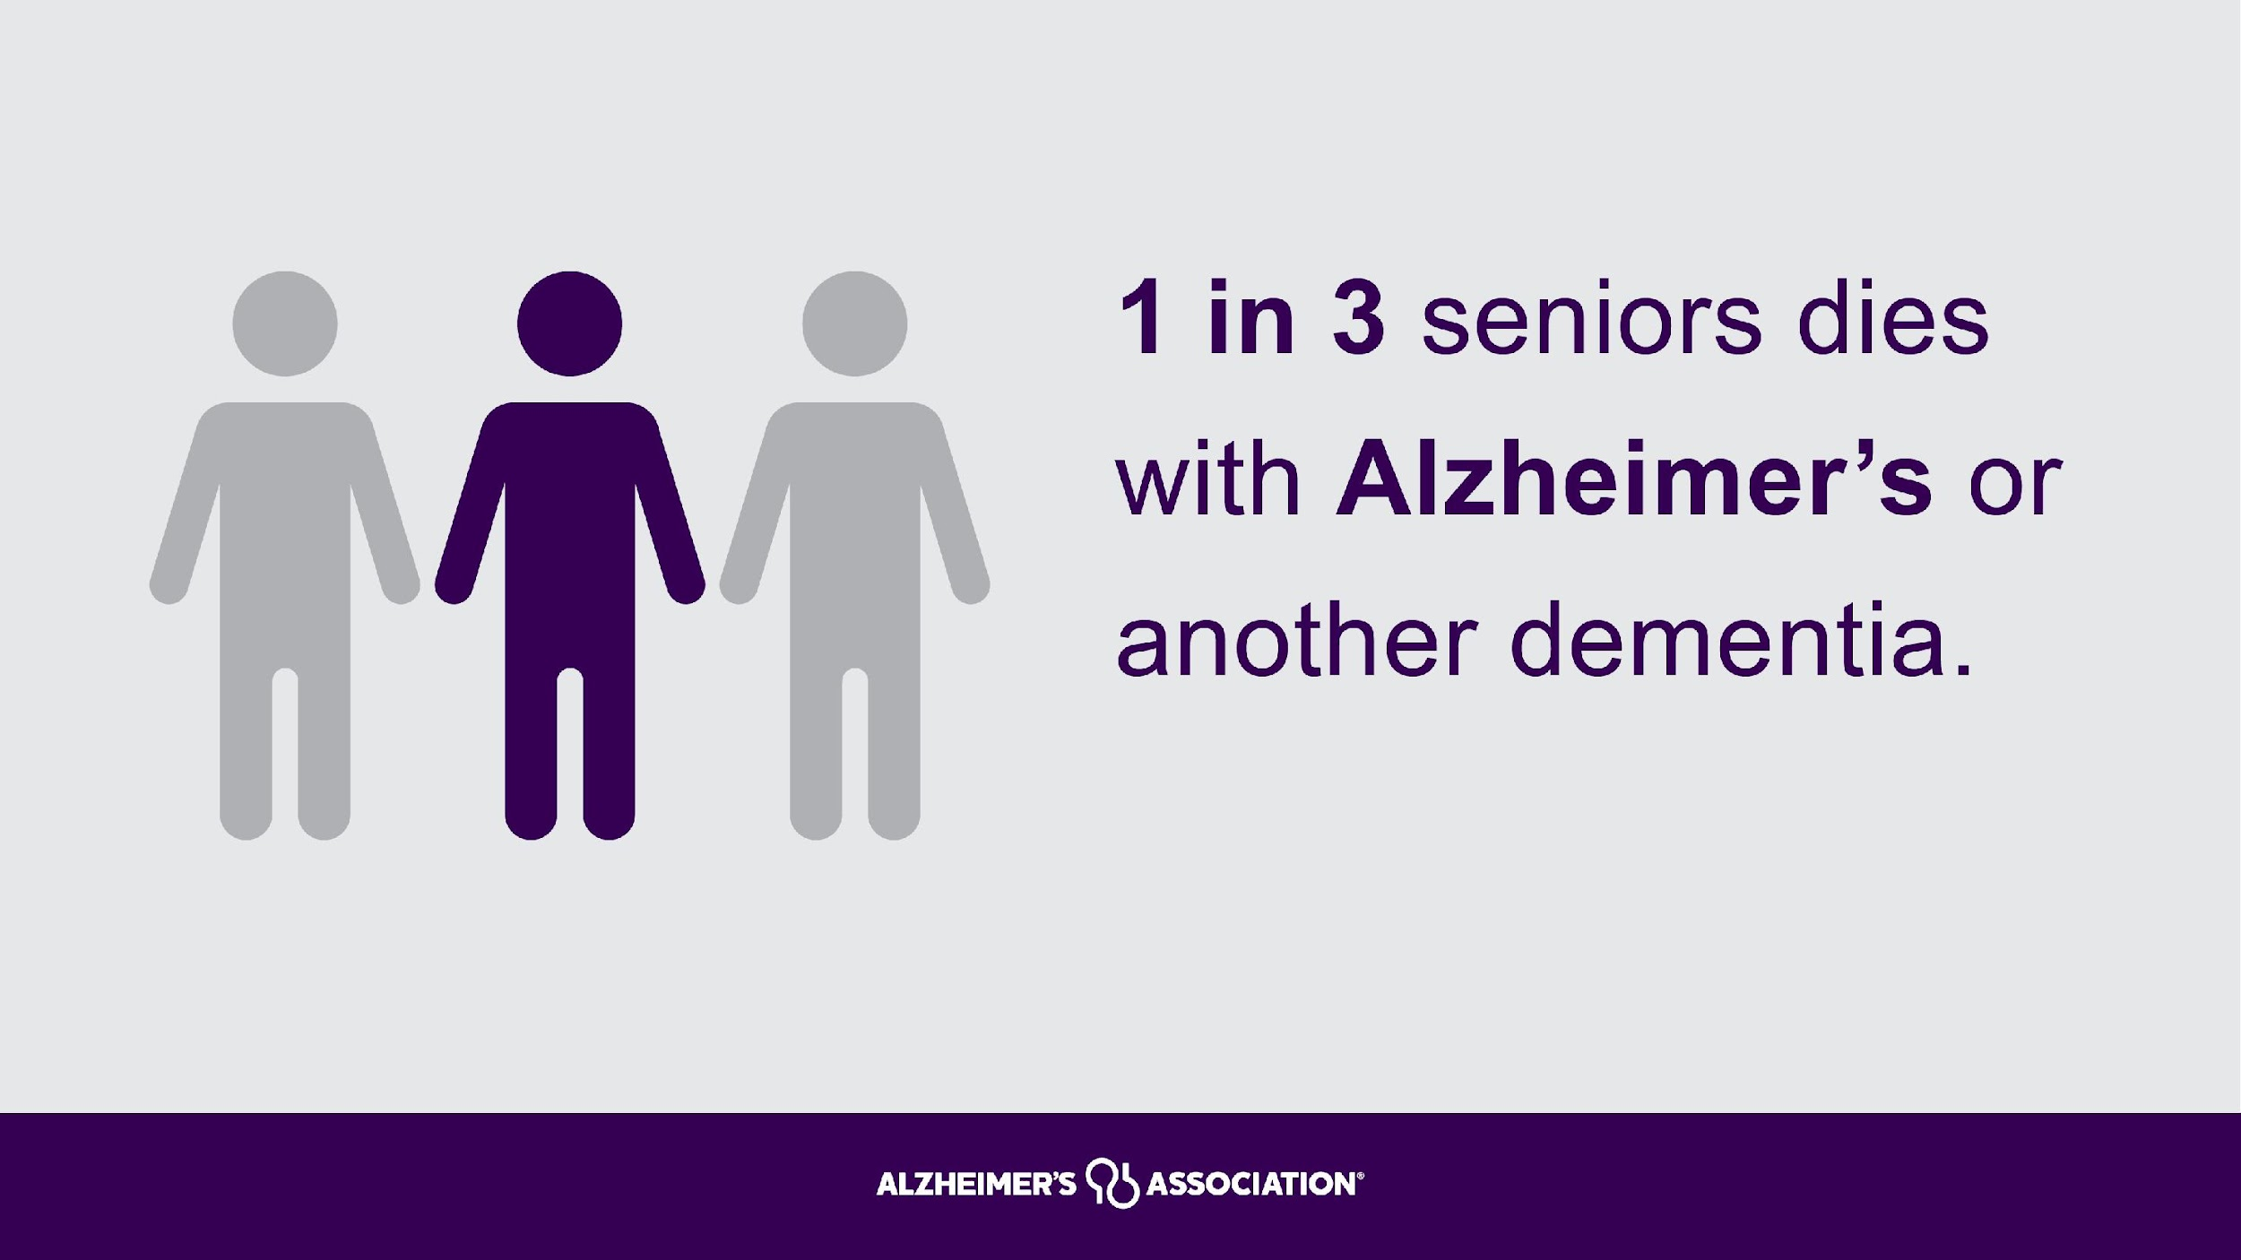

Slide 7
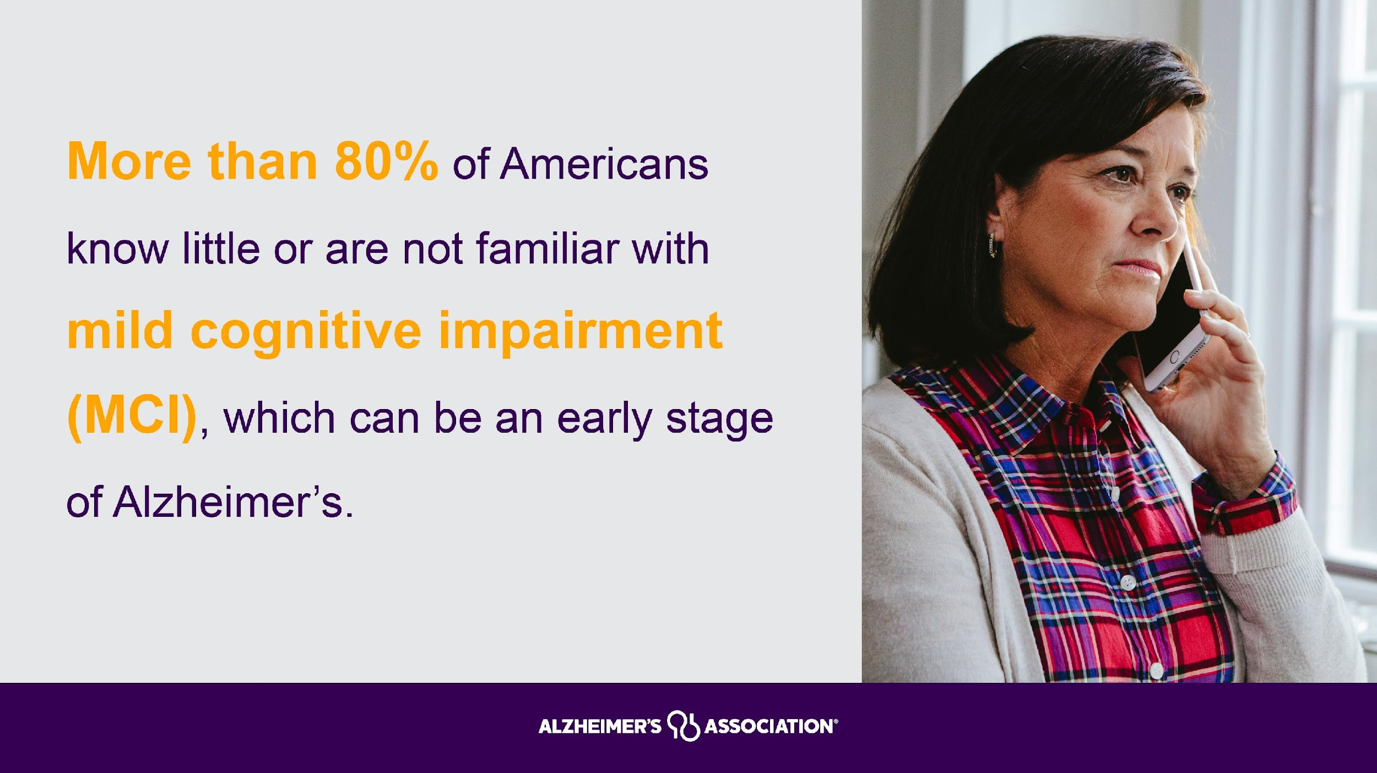

Slide 8
True or False: Alzheimer’s/Dementia is a normal part of aging.
False
Disorders grouped under the general term “dementia” are caused by abnormal brain changes. These changes trigger a decline in thinking skills, also known as cognitive abilities, severe enough to impair daily life and independent function. They also affect behavior, feelings and relationships.
Notes:
Disorders grouped under the general term “dementia” are caused by abnormal brain changes. These changes trigger a decline in thinking skills, also known as cognitive abilities, severe enough to impair daily life and independent function. They also affect behavior, feelings and relationships.

Slide 9
Types of Dementia
Dementia:
Alzheimer’s
Vascular
Lewy body
Frontotemporal
Other, including Huntington’s
An ‘umbrella’ term used to describe a range of symptoms associated with cognitive impairment
Mixed dementia: dementia from more than one cause
Notes:
Just to make sure we’re all on the same page with some important definitions….we talk about Alzheimer’s and dementia. Raise your hand if you feel like you know the difference. {call on a participant if possible}
Let me tell you a bit about dementia and Alzheimer’s. Dementia is a general term for loss of memory, language, problem-solving and other thinking abilities that are severe enough to interfere with daily life. Alzheimer's is the most common cause of dementia.
Dementia is not a single disease; it’s an overall term — like heart disease — that covers a wide range of specific medical conditions, including Alzheimer’s disease. Disorders grouped under the general term “dementia” are caused by abnormal brain changes. These changes trigger a decline in thinking skills, also known as cognitive abilities, severe enough to impair daily life and independent function. They also affect behavior, feelings and relationships.
Alzheimer's disease accounts for 60-80% of cases. Vascular dementia, which occurs because of microscopic bleeding and blood vessel blockage in the brain, is the second most common cause of dementia. Those who experience the brain changes of multiple types of dementia simultaneously have mixed dementia. There are many other conditions that can cause symptoms of dementia, including some that are reversible, such as thyroid problems and vitamin deficiencies.
You might have heard the term "senility" or "senile dementia," which is what many people formerly called dementia when there was a commonly accepted belief that serious mental decline is a normal part of aging. Science now knows there are multiple causes of dementia, and many different symptoms which may include:
Problems with short-term memory
Keeping track of a purse or wallet
Paying bills
Planning and preparing meals
Remembering appointments
Getting lost in a familiar neighborhood
Often dementia will start out slowly and gradually get worse. If you or someone you know is experiencing memory difficulties or other changes in thinking skills, don't ignore them. See a doctor soon to determine the cause. And also get connected to help and support to answer your questions and guide you through this diagnosis.

Slide 10
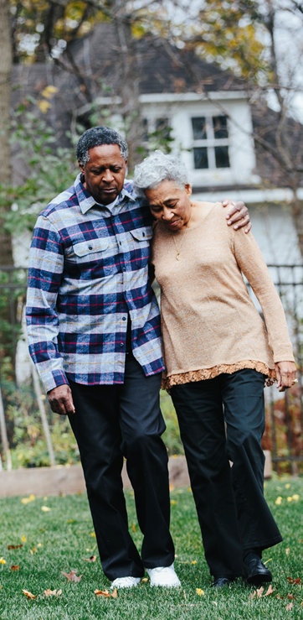
The Progression of Alzheimer’s is Slow and Burdensome
People age 65+ survive an average of four to eight years after a diagnosis, yet some live as long as 20 years.
Individuals who live from age 70 to age 80 with Alzheimer’s dementia will spend an average of 40% of this time in dementia’s most severe stage.
The long duration of the disease contributes significantly to the public health impact of Alzheimer’s.

Slide 11
Alzheimer’s Caregivers Report High Emotional and Physical Stress
Nearly 6 in 10 (59%) family caregivers of people with Alzheimer’s or other dementias rated the emotional stress of caregiving as high or very high.
74% of caregivers reported they were “somewhat concerned” to “very concerned” about maintaining their own health.
30% increase in depressive symptoms while caring for a spouse.
59% of caregivers felt they were “on duty” 24 hours a day in the year before the death of the person with the disease.
72% of family caregivers experienced relief when the person with Alzheimer’s or another dementia died.

Slide 12
Resources for Oklahomans
Oklahoma Chapter of Alzheimer’s Association:
Education - information about Alzheimer's and other dementia meant for caregivers and the general public
Support Groups - Support and information for Caregivers
Early Stage Engagement - Support and social interaction for persons with dementia

Slide 13
Resources for Oklahomans
Oklahoma Chapter of Alzheimer’s Association:
Care Planning - In person meetings or tele/video meetings to plan and get resources
Material Resources - Brochures, books, info-cards to educate caregivers, family and friends
1-800-272-3900
24/7 National Number

Slide 14
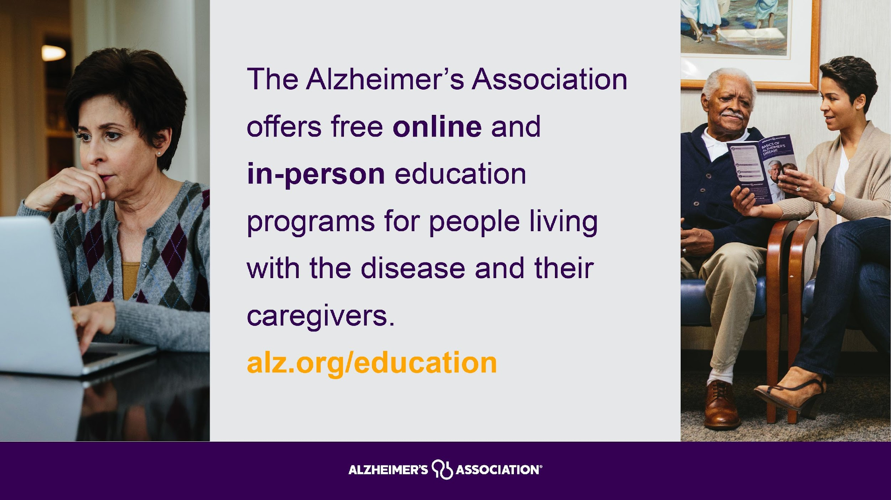

Slide 15
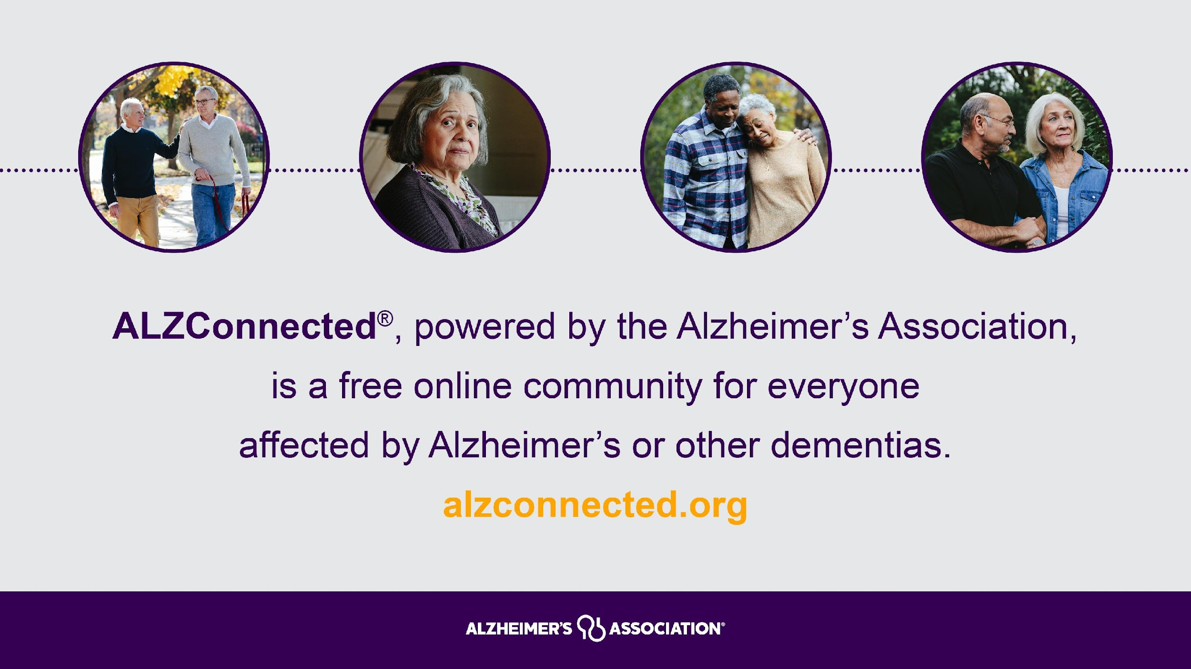

Slide 16
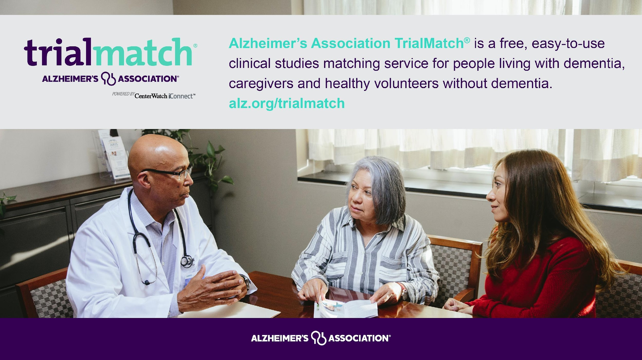

Slide 17



How The Alzheimer’s Association Can Help
24/7 HELPLINE
FREE EDUCATION
ALZ & AARP COMMUNITY RESOURCE FINDER
The Alzheimer’s Association 24/7 Helpline (800.272.3900) is available around the clock, 365 days a year.
Through this free service, specialists and master’s-level clinicians offer confidential support and information to people living with dementia, caregivers, families and the public.
Find dementia and aging-related resources that connect individuals facing dementia with local programs and services at alz.org
Get easy access to resources, community programs and services in your local community at communityresourcefinder.org
Find dementia and aging-related resources that connect individuals facing dementia with local programs and services at alz.org
Notes:
The Alzheimer’s Association offers free resources to the millions of people facing Alzheimer’s disease, including:
Our 24/7 Helpline
The Alzheimer’s Association free 24/7 Helpline (800.272.3900) offers confidential support and information to anyone facing Alzheimer's or dementia.
Free Education Programs
Access free online education programs on the basics of the disease, caregiving and more.
The Alzheimer’s Association & AARP Community Resource Finder
Get easy access to dementia resources, community programs and services.

